Slide 1
Using GROBID-Dictionaries to encode the German-Serbian mining dictionary
Biljana Lazić

Slide 2
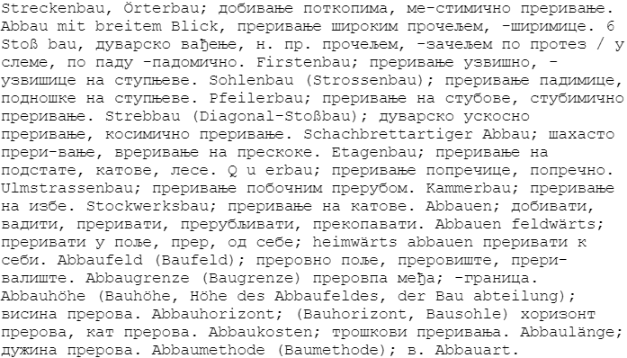
Abby OCRised dictionary without corrections

Slide 3
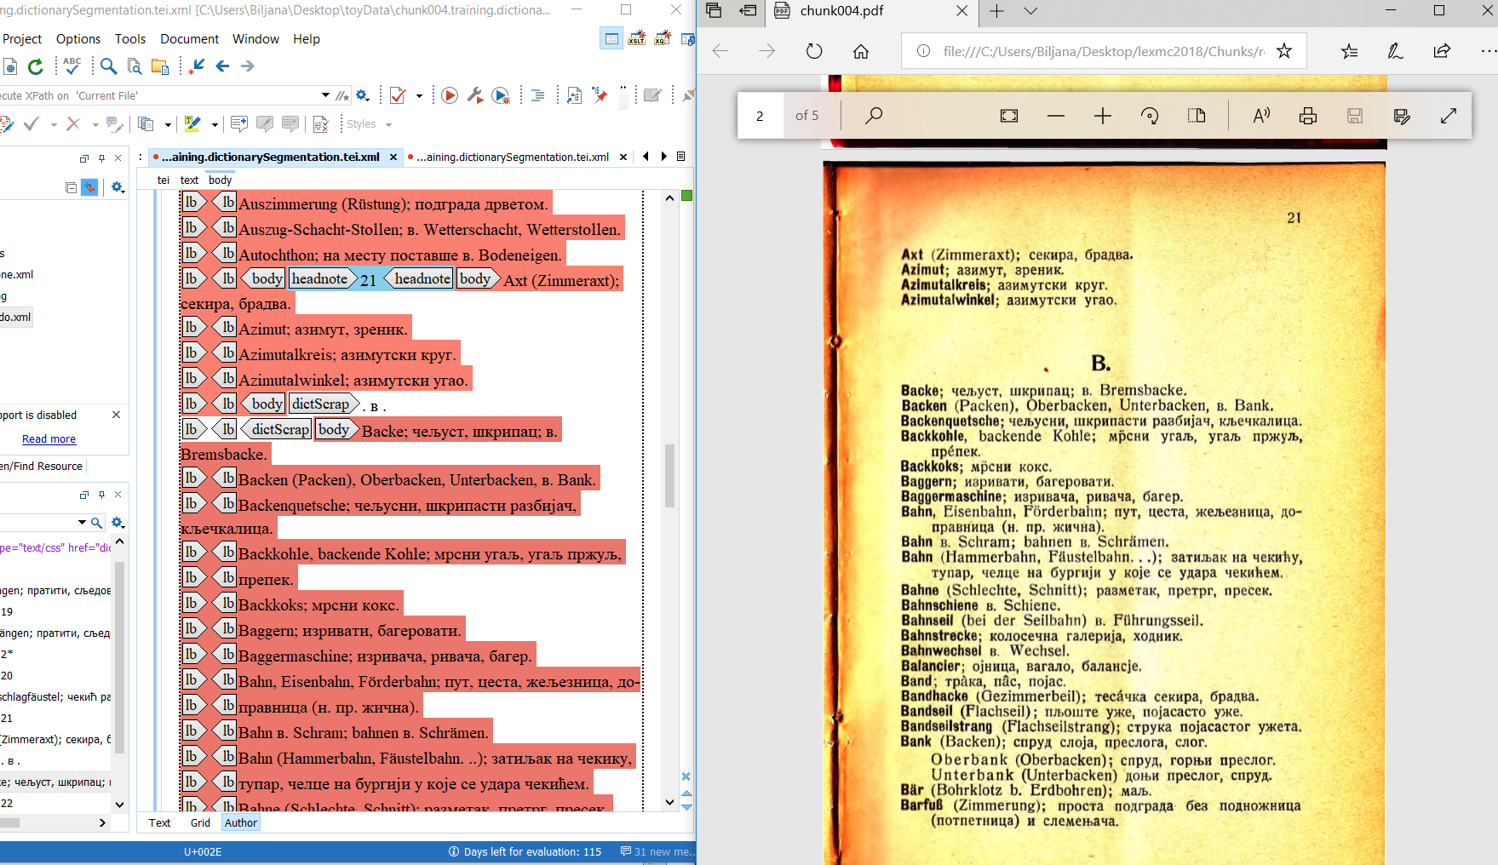

Dictionary Segmentation model

Slide 4
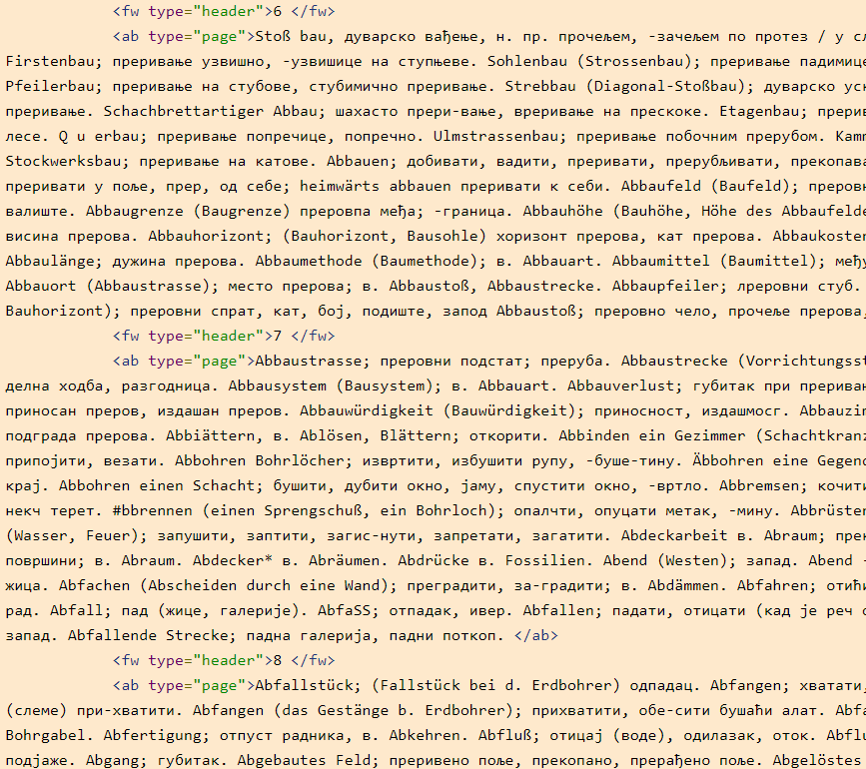
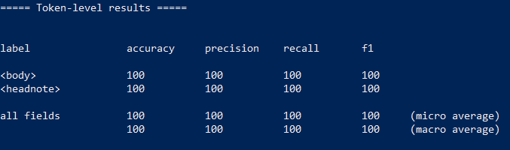
Dictionary Segmentation model

Slide 5
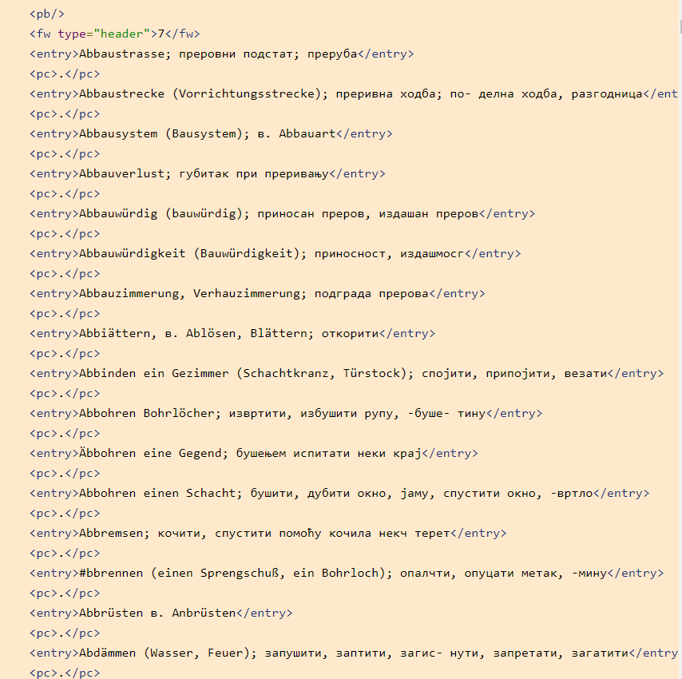
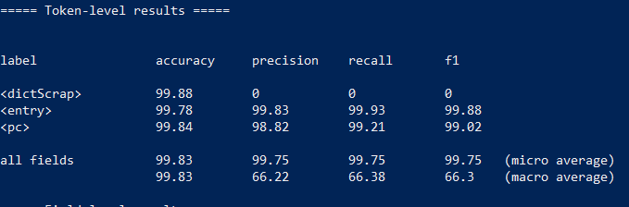
Dictionary Body Segmentation model

Slide 6
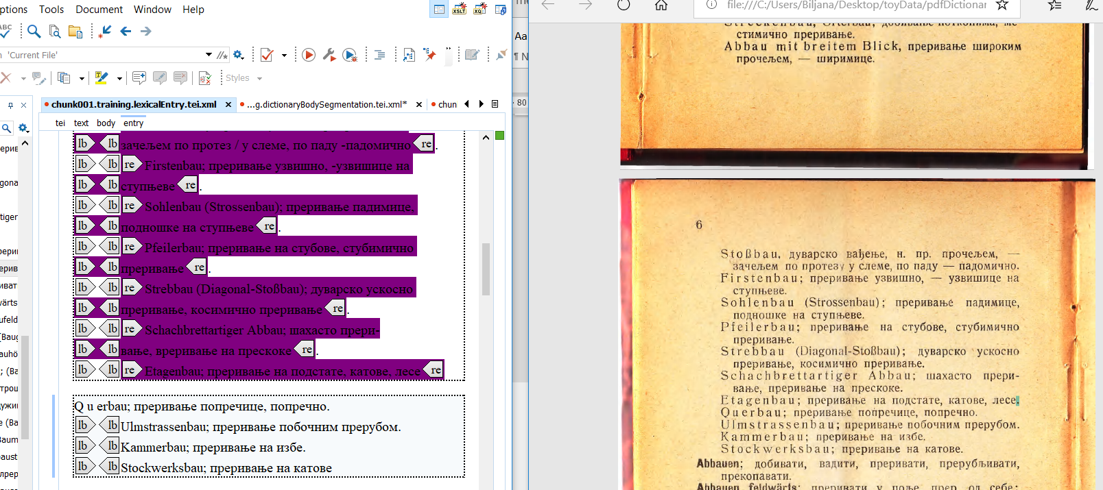
Lexical Entry model

Slide 7
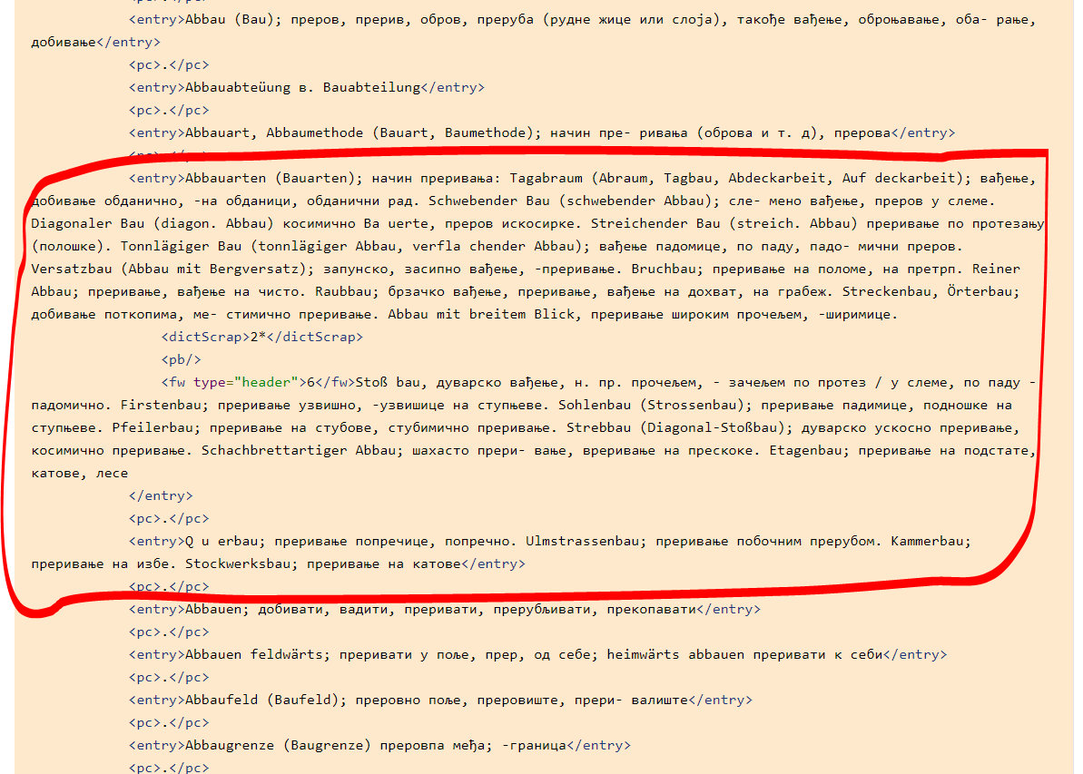

Slide 8
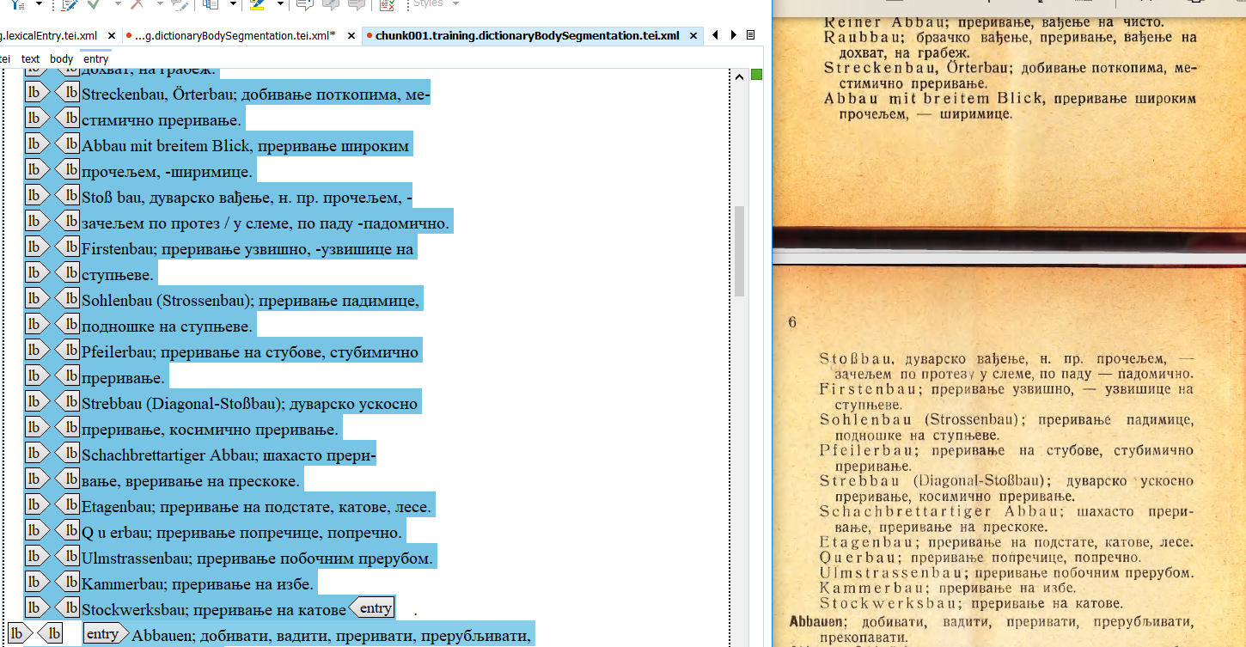
Despite the fact that…

Slide 9
The result: Dictionary Body Segmentation model

Slide 10
Conclusion:
I need to train more data for Dictionary Body Segmentation model
Now I can use Grobid dictionaries on “real data”

Slide 11
Thank you!

